Slide 1

Designing a Modern Data Architecture with Cloud Computing
Presented by : Sayh Ilyas Supervised by : Mr Mohamed amin talhaoui

Slide 2
Introduction to Modern Data Architecture
Data-Driven Decision Making
Real-time Insights
Data as a Strategic Asset
Modern data architecture empowers organizations to leverage data for informed decision making, driving better business outcomes.
By integrating data from various sources, modern architecture enables real-time data analytics and proactive decision-making.
Modern data architecture recognizes data as a valuable asset, requiring effective management and utilization.

Slide 3

Benefits of Cloud Computing for Data Architecture
Scalability and Elasticity
Cost Optimization
Cloud infrastructure offers on-demand scalability, enabling organizations to adjust resources as needed, ensuring efficient resource utilization.
Pay-as-you-go pricing models and cost-efficient cloud services can significantly reduce infrastructure costs.
Increased Agility
Enhanced Security
Cloud computing provides rapid deployment and updates, allowing organizations to adapt quickly to changing business needs.
Cloud providers invest heavily in robust security measures, safeguarding sensitive data and protecting against potential threats.

Slide 4
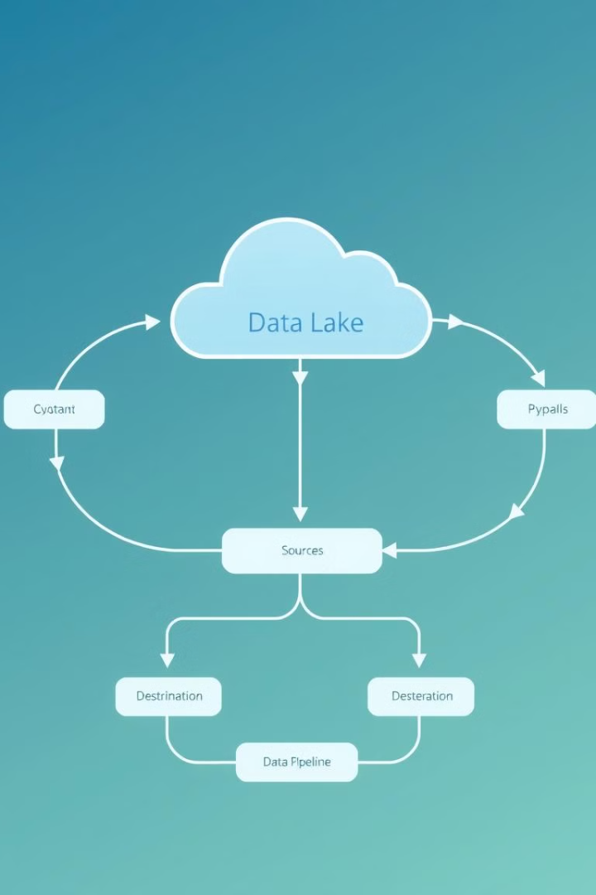
Key Components of a Cloud-Based Data Architecture
Data Lake
Data Warehouse
A centralized repository for storing raw data from various sources, providing a single source of truth.
A structured repository for storing cleansed and transformed data for analytical purposes.
Data Pipelines
Data Governance and Security
Automated processes that ingest, transform, and load data from various sources into the data lake or warehouse.
Comprehensive policies and procedures to ensure data quality, access control, and compliance.

Slide 5




Strategies for Data Ingestion and Integration in the Cloud
Data Extraction
Data Transformation
Data Loading
Extracting data from various sources, including databases, APIs, and files.
Converting data into a consistent format, cleaning, and enriching it for analysis.
Loading transformed data into the designated data lake or warehouse.

Slide 6

Leveraging Cloud-Native Data Storage and Processing
1
Cloud Storage Services
Utilizing cost-effective and scalable storage solutions like Amazon S3, Azure Blob Storage, or Google Cloud Storage.
2
Cloud Data Warehouses
Leveraging fully managed cloud data warehouses like Snowflake, BigQuery, or Redshift for efficient data analysis.
3
Serverless Computing
Employing serverless computing services like AWS Lambda, Azure Functions, or Google Cloud Functions for scalable data processing.

Slide 7




Ensuring Data Governance and Security in the Cloud
1
Access Control
Data Encryption
2
Protecting data at rest and in transit with robust encryption mechanisms.
Compliance
3
Adhering to industry regulations like GDPR and HIPAA for data privacy and security.
Data Masking and Anonymization
4
Protecting sensitive data by masking or anonymizing it for analysis.

Slide 8
Modernizing Legacy Data Systems with the Cloud
Data Migration Strategy
1
Planning and executing a phased migration of legacy data systems to the cloud.
Data Transformation
2
Transforming legacy data formats and structures to be compatible with cloud platforms.
Cloud-Native Applications
3
Developing or migrating applications to leverage cloud-native services and technologies.

Slide 9

Conclusion and Next Steps
1
2
3
Modernize
Integrate
Innovate
Embrace cloud computing to modernize data architecture and unlock its potential.
Integrate data from diverse sources to gain comprehensive insights and informed decision-making.
Leverage cloud-native technologies for innovative data-driven solutions and business transformation.

